Slide 1
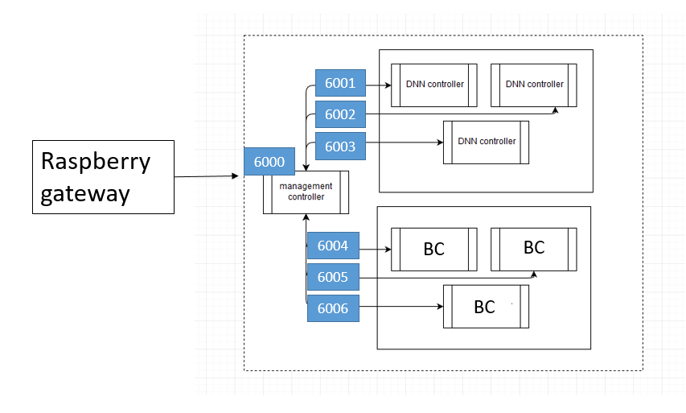
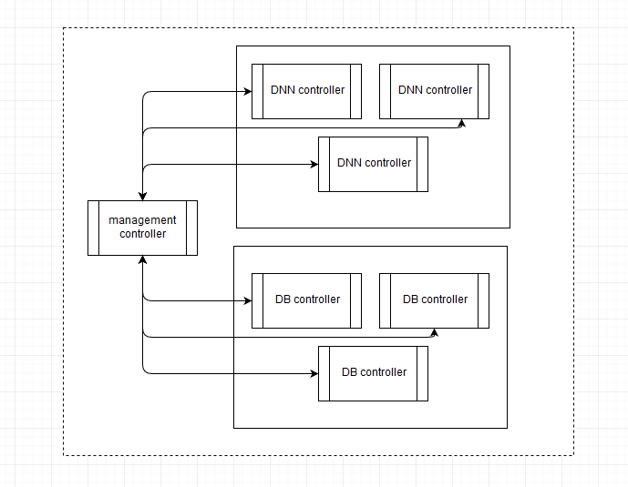
Docker Inner Network
6001
6002
Raspberry gateway
6003
6000
6004
6005
6006

Slide 2
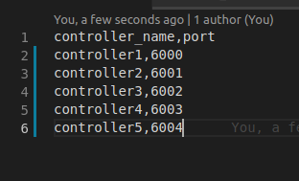
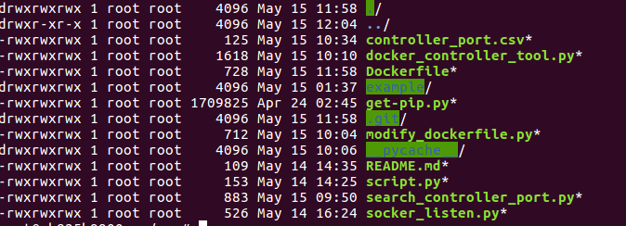
Inner Controller
Continuous monitoring

Slide 3
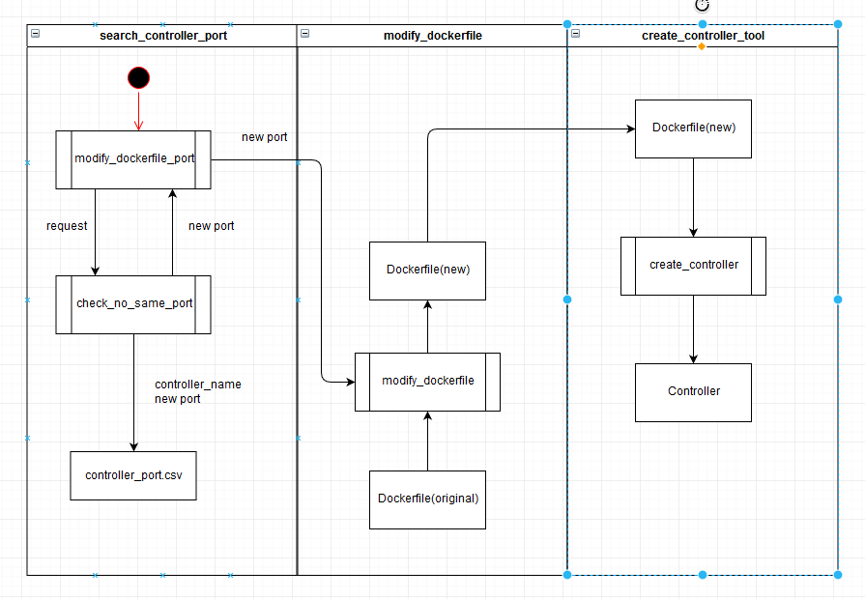
Data Flowing:

Slide 4
Future Work
Automatic deployment:
Let controller being auto-created
Auto-running socket_listen.py
Auto-modifying Dockerfile(port)
Build & Run Dockerfile

